Slide 1
Priority Setting in healthcare in Chile: considerations of Social Value Judgements
Marianela Castillo-Riquelme
Newton-Picarte Project
London, 30 of March – 1st April, 2016
NICE - KCL

Slide 2
Outline of the presentation
The general context
Background on priority setting, HTA and social preferences in the country
The values o principles around the national health programmes with universal coverage
AUGE (Universal Access with Explicit Entitlements )
High cost treatment fund (2015)
Research status on SVJ (short /long term)
Conclusions

Slide 3
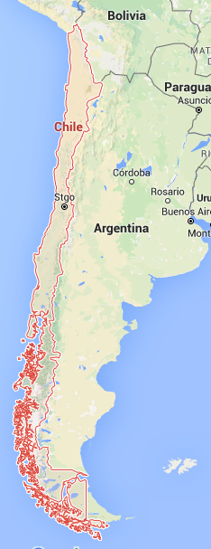
CHILE: The healthcare context
Population = 17,9 millions (2015)
GDP per capita = US$14.520 (World Bank - 2014 )
Life expectancy at birth: 80 years (77m/83w)
Birth rate: 13 per 1000 population
Poor population (%): 14.4
Per capita healthcare expenditure as % of the GDP: 7.7 (47% is publicly funded)
Per capita healthcare expenditure (USD): 1204
Some epidemiology figures
High prevalence of chronic conditions (Hypertension, diabetes, cancer, traumatisms)
Obesity: 8.7% -10% in children under 5 yr (men & women)
Over weight: 9,3% in children under 5 yr
Smoking prevalence: 37% -42% in adult population (men & women)
Source: World bank data
http://datos.bancomundial.org/indicador/SH.STA.OWGH.ZS
Notes:
14,520.0
FONASA : 75% de los pacientes
ISAPRE: 16% de la población

Slide 4
CHILE: The healthcare system
Health System: Public/private mixt with health insurance: FONASA & ISAPRES
FONASA (public pooled fund)
ISAPRE (individual-based fund)
High out-of-pocket payments (33- 37 % OCDE)
National health programmes, with universal coverage
AUGE plan (Universal Access with Explicit Entitlements – health package covering 80 health conditions – also known as GES)
High cost treatment Fund NEW LAW! (11 treatments covered from 2016)
Notes:
14,520.0
FONASA : 75% de los pacientes
ISAPRE: 16% de la población

Slide 5
Pathway to priority setting en Chile: main milestones
Burden of Disease Studies
1995
2007
First cost-effectiveness study (1999)
AUGE Law requires specific studies, criteria and protocols
2005
(generalised) Cost-effectiveness study to inform AUGE (2008-10)
AUGE studies
interventions effectiveness (2007)
Social preferences (2008)
Guidelines:
Reference case for EE (2013)
Handbook for CPG development (2014)
New fund for High cost treatment– Explicit evaluation and HTA process 2015
National Commission on HTA (2012)
Notes:
Studies required by law
Budget impact analysis

Slide 6
The institutional setting for priority setting
FONASA (various departments)
Department of health economics (Ministry)
Universities (when studies are commissioned)
HTA Department (Ministry)
Evidential studies for AUGE Department (Ministry)
Clinical experts and scientific societies
Patients
AUGE programme
Prevention and promotion
programmes
National Immunisation Programme
New Fund for high cost treatments
Notes:
Studies required by law
Budget impact analysis

Slide 7
Considerations for SVJ in healthcare decisions in Chile
There are no social value judgments established
Specific programmes set up process and content values
AUGE and the High Cost treatment Fund
The National Commission on HTA set up 7 principles
There are few examples of eliciting social preferences in Chile:
“Estudio de preferencias sociales para la definición de las garantías explícitas en Salud, 2008” (3 studies );
Revisión del Proceso de Priorización de las Garantías Explicitas en Salud (AUGE) → Qualitative perspective
Transparency law obligates the Ministry to answer any questions that citizens and community pose

Slide 8
Characteristics of the studies of social preferences in health
Issue | Prioritization of health investments (1996) | Initial studies on health perception (2000) | Determination of health priorities proposed in the implementation of AUGE (2005)
Data collection instrument | 18 Discussion groups | 22 Discussion groups | 12 Discussion groups 12 citizen analysis workshops
Social criteria identified | Position of the individual and the group about health, perceived severity and intensity of the symptom, knowledge of the health problem and treatment, present time value | Construction of the concept of health, self-care, prevention, disability, access to complex interventions | Social criteria for prioritizing health (death risk, costs, access, gender, social functioning)
Contribution to public policy | Understanding social preferences | Scenario analysis for health care reform and the perception of citizens | Ordering of social preferences
Target population (unit of analysis) | Public health insured (Santiago- FONASA) | Public and private health insured (4 regions, only women) | Public and private health insured (4 regions. Men and women)

Slide 9
AUGE (GES) health reform - 2004
Universal healthcare package with explicit entitlements (AUGE/GES)
Access
Opportunity
Financial protection
Quality
Interventions covered have been gradually increasing: from 25 in 2005 to 80 in 2013
Establishes prioritization criteria: burden of disease, effectiveness, vulnerability (ability to benefit), disease impact on people, cost, financial burden on HH => potential demand, network/supply capacity
Established specific studies: epidemiological studies, actuarial/budget impact analysis, social preferences, cost-effectiveness “when possible”.
The law highlights the “evidence” as the basis of prioritization
Establishes the “AUGE Advisory Board” (9 members of recognized competence in the field of medicine, public health, economics, bioethics, health law and related subjects)

Slide 10
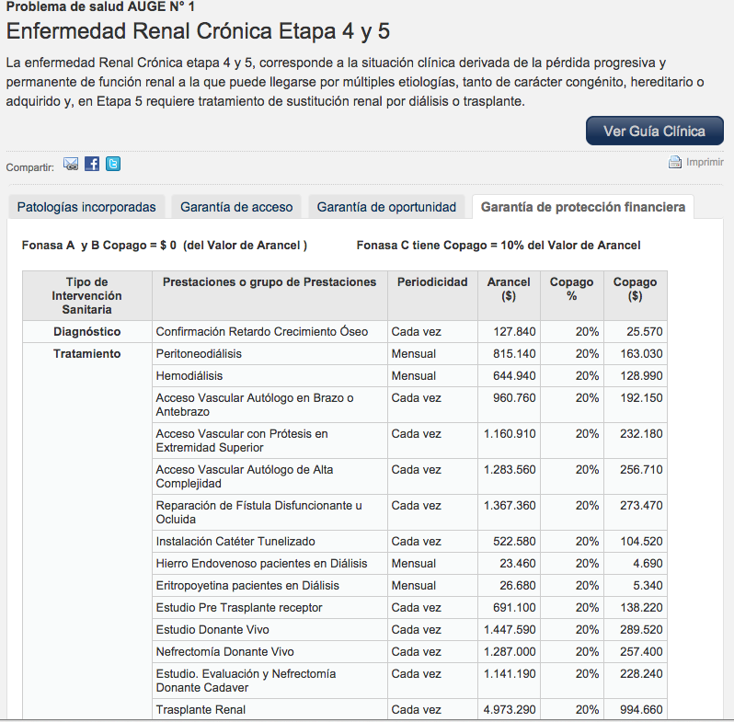
How does AUGE(GES) works?

Slide 11
The prioritization process of AUGE
Conditions Prioritized
Interventions selected for analysis
Feasibility for implementation
Epidemiology
Burden of disease
Efectiveness of treatments
Impact in QoL
Social preferences
Recommendation in CPG
Scientific evidence
Cost
Cost-effectiveness
Impact on QOL
Social preferences
Capacity of the system (HHRR & care network)
Available resources
Implementation implications
But… decisions made in each step and its reasons are not always/well documented…
Evidence is not always available (resources to conduct studies, reviews and CEA are still limited…)
Political timing implies that decisions need to be taken in short time

Slide 12
National Commission on HTA (2012)
Composed of 19 members from 6 institutions
Main objectives
To conduct a diagnosis of HTA (at the national & international level)
To propose a model for HTA implementation
To support decision-making in specific themes
Model for HTA implementation in Chile
Establishes principles for conducting HTA
Addresses guidance on methods and processes for HTA
Considers a roadmap for transitioning from the short to the long term
Notes:
140 millions USD

Slide 13
The proposed HTA model
http://web.minsal.cl/sites/default/files/files/InformeFinalPropuestaETESAChile.pdf
Principles
Independence
Roadmap
Capacity building
Institutionalization
Independent institution
Transparency
Probity
Participation
Ethics
Universality
Equity
Strengthen HTA–related research
Collaboration with international networks
Promote centralized procurement
Regulate medical devices
Based decisions on HTA results
Centralised (national referent)
With a legal mandate
With the appropriate resources
Wide scope for evaluation
Notes:
Beneficiency, non maleficiency and

Slide 14
New Law Ricarte Soto for high cost treatments ( 2015)
Purpose: ensure access to high cost diagnoses and treatments (drugs, medical devices and special food)
Principles: Equity, Solidarity, Efficacy and Social Participation
No co-payments
Prioritization
Calls for a regulated process to determine included interventions
Calls for a review of evidence: considering “high cost”, efficacy, effectiveness, economic evaluation, budget impact, implementation feasibility and other ethical, social and legal implications
Implementation innovations
Unique network of providers
Centralized purchase
Risk sharing agreements
Space for price negotiation
Introduction of reference pricing
Patients public manifestation
Foto: La Tercera
Notes:
SI

Slide 15
Social participation in the New Law - Ricarte Soto
Permanent
Creating of the Citizens Commission for Surveillance and Control
Implementing a registry of organised patient groups
At each evaluation process
Demanding the evaluation
Patients or citizens' organizations, should be specially listened to
In the recommendation process
Appealing
As part of the Commision
Patients public manifestation
Foto: La Tercera
Notes:
SI

Slide 16
First inclusions of this new law (2016)
Mucopolysaccharidoses Type I | Laronidasa
Mucopolysaccharidoses Type II | Idursulfasa
Mucopolysaccharidoses Type VI | Galsulfasa
Tyrosinemia Type I | Nitisinona
Rheumatoid Arthritis | Abatacept o Rituximab
Multiple Sclerosis | Fingolimod o Natalizumab
Gaucher | Taliglucerasa o Imiglucerasa
Fabry | Agalsidasa
Pulmonary Hypertension - Group I | Iloprost inhalatorio, Ambrisentan o Bosentan
Extremely preterm new-born with bronchopulmonary dysplasia | Palivizumab
Breast cancer | Trastuzumab
Notes:
SI SOLO LA CONDICION

Slide 17
So, how are we doing in line with the reviewed frameworks?
Norman Daniels (2008): Accountability for reasonableness
Relevance, Publicity, Appeal and review, Enforcement
Clark and Weale (2011): The framework has 8 criteria or values of decision making in health priority setting:
3 general process values: Accountability, Transparency and Participation
5 values of content: Clinical effectiveness, cost-effectiveness, justice/equity, solidarity and autonomy.
Decision Making Audit Tool (DMAT)
Mix of previous tools
4 process values: Institutional setting, Accountability, Transparency and Participation
4 content values: Effectiveness, cost-effectiveness, fairness and solidarity.
“Making Fair choices” approach
3 criteria: cost-effectiveness, priority to the worse-off, risk protection
Accountable and participative process (institutionalized) = A4R

Slide 18
How to progress researching SVJ in Chile
Overall objective: making recommendations on how to structure participative and transparent processes for priority setting in healthcare, that adequately represent SVJ of Chilean citizens
This imply…
Knowing which values prevails today and which values are the relevant according to the Chilean population
Eliciting decision makers’ values and contrasting them with the elicited population values
Selecting the right tools/approaches for the previous points
Considerations for this grant (ending in August)
General Objective: conceptualizing the full study (writing the full protocol)
Literature review of approaches and tools available
Translating and pilot-testing DMAT (budget of £3,500)
Product: full proposal to study SVJ in Chile (application for a larger grant)

Slide 19
Conclusions
The concepts of fairness, accountability and participation are imbedded in the system (AUGE and High Cost treatment)
But…
Evidence is not always available or its quality is not always good
Implicit priority setting still quite prevalent – lack of transparency
Not always is there someone to be held accountable (Transparency Law)
Rules of engagements for social participation need to be clear
Some contested values in AUGE are age
Space for improvement…
Researching SVJ in Chile
Learning how to improve transparency of processes
Learning how to enable effective social participation
Full research proposal for a larger grant (possible another Newton-Picarte)
Notes:
SI

Slide 20
¡ Muchas gracias !

